Slide 1
How Do We Compare Biological Sequences?
Dynamic Programming and
Divide-and Conquer Algorithms
Phillip Compeau and Pavel Pevzner.
Bioinformatics Algorithms: An Active Learning Approach
©2018 by Compeau and Pevzner. All rights reserved.

Slide 2
How Do We Compare Biological Sequences
From Sequence Comparison to Biological Insights
The Alignment Game and the Longest Common Subsequence
The Manhattan Tourist Problem
The Change Problem
Dynamic Programming and Backtracking Pointers
From Manhattan to the Alignment Graph
From Global to Local Alignment
Penalizing Insertions and Deletions in Sequence Alignment
Space-Efficient Sequence Alignment
Multiple Sequence Alignment

Slide 3
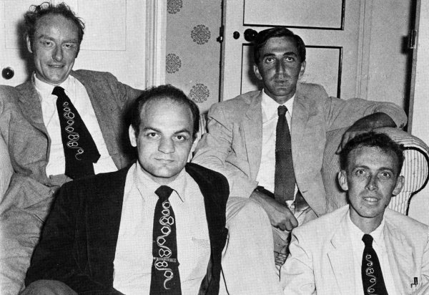
RNA Tie Club
ribosome
DNA → RNA → Protein
genetic code
RNA tie club

Slide 4
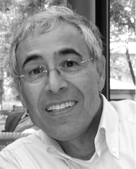
From Genetic Code to Non-Ribosomal Code
non-ribosomal peptide synthetase
ribosome
DNA → RNA → Protein → Peptide
genetic code
non-ribosomal code
RNA tie club Marahiel

Slide 5
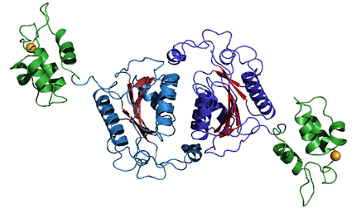
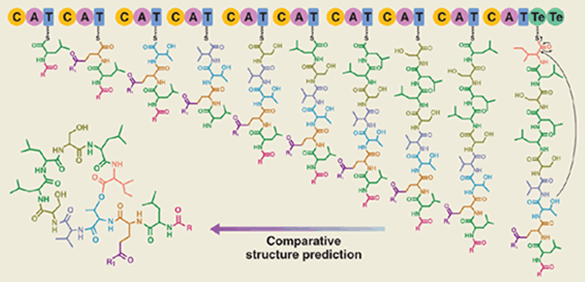
NRP Synthetase: A Giant Molecular Assembly Line
Adenylation domains
A1
A2
A3
A4
A5
A6
A7
A8
A9
A10
NRP synthetase adds one amino acid at a time

Slide 6
These Three A-domains Do Not Look Similar
YAFDLGYTCMFPVLLGGGELHIVQKETYTAPDEIAHYIKEHGITYIKLTPSLFHTIVNTASFAFDANFESLRLIVLGGEKIIPIDVIAFRKMYGHTEFINHYGPTEATIGA
AFDVSAGDFARALLTGGQLIVCPNEVKMDPASLYAIIKKYDITIFEATPALVIPLMEYIYEQKLDISQLQILIVGSDSCSMEDFKTLVSRFGSTIRIVNSYGVTEACIDS
IAFDASSWEIYAPLLNGGTVVCIDYYTTIDIKALEAVFKQHHIRGAMLPPALLKQCLVSAPTMISSLEILFAAGDRLSSQDAILARRAVGSGVYNAYGPTENTVLS

Slide 7
These Three A-domains Do Not Look Similar
YAFDLGYTCMFPVLLGGGELHIVQKETYTAPDEIAHYIKEHGITYIKLTPSLFHTIVNTASFAFDANFESLRLIVLGGEKIIPIDVIAFRKMYGHTEFINHYGPTEATIGA
AFDVSAGDFARALLTGGQLIVCPNEVKMDPASLYAIIKKYDITIFEATPALVIPLMEYIYEQKLDISQLQILIVGSDSCSMEDFKTLVSRFGSTIRIVNSYGVTEACIDS
IAFDASSWEIYAPLLNGGTVVCIDYYTTIDIKALEAVFKQHHIRGAMLPPALLKQCLVSAPTMISSLEILFAAGDRLSSQDAILARRAVGSGVYNAYGPTENTVLS
just 3 conservative columns

Slide 8
Do they look similar now?
YAFDLGYTCMFPVLLGGGELHIVQKETYTAPDEIAHYIKEHGITYIKLTPSLFHTIVNTASFAFDANFESLRLIVLGGEKIIPIDVIAFRKMYGHTEFINHYGPTEATIGA
-AFDVSAGDFARALLTGGQLIVCPNEVKMDPASLYAIIKKYDITIFEATPALVIPLMEYIYEQKLDISQLQILIVGSDSCSMEDFKTLVSRFGSTIRIVNSYGVTEACIDS
IAFDASSWEIYAPLLNGGTVVCIDYYTTIDIKALEAVFKQHHIRGAMLPPALLKQCLVSAPTMISSLEILFAAGDRLSSQDAILARRAVGSGVYNAYGPTENTVLS
11 conservative columns

Slide 9
And now?
YAFDLGYTCMFPVLLGGGELHIVQKETYTAPDEIAHYIKEHGITYIKLTPSLFHTIVNTASFAFDANFESLRLIVLGGEKIIPIDVIAFRKMYGHTE-FINHYGPTEATIGA
-AFDVSAGDFARALLTGGQLIVCPNEVKMDPASLYAIIKKYDITIFEATPALVIPLMEYI-YEQKLDISQLQILIVGSDSCSMEDFKTLVSRFGSTIRIVNSYGVTEACIDS
IAFDASSWEIYAPLLNGGTVVCIDYYTTIDIKALEAVFKQHHIRGAMLPPALLKQCLVSA----PTMISSLEILFAAGDRLSSQDAILARRAVGSGV-Y-NAYGPTENTVLS
19 conservative columns!

Slide 10
Red Positions Encode Conservative Core of A-domains
YAFDLGYTCMFPVLLGGGELHIVQKETYTAPDEIAHYIKEHGITYIKLTPSLFHTIVNTASFAFDANFESLRLIVLGGEKIIPIDVIAFRKMYGHTE-FINHYGPTEATIGA
-AFDVSAGDFARALLTGGQLIVCPNEVKMDPASLYAIIKKYDITIFEATPALVIPLMEYI-YEQKLDISQLQILIVGSDSCSMEDFKTLVSRFGSTIRIVNSYGVTEACIDS
IAFDASSWEIYAPLLNGGTVVCIDYYTTIDIKALEAVFKQHHIRGAMLPPALLKQCLVSA----PTMISSLEILFAAGDRLSSQDAILARRAVGSGV-Y-NAYGPTENTVLS
Which positions are responsible for encoding different amino acids Asp, Orn, Val?

Slide 11
Blue Positions in A-domains Define Non-Ribosomal Code
YAFDLGYTCMFPVLLGGGELHIVQKETYTAPDEIAHYIKEHGITYIKLTPSLFHTIVNTASFAFDANFESLRLIVLGGEKIIPIDVIAFRKMYGHTE-FINHYGPTEATIGA
-AFDVSAGDFARALLTGGQLIVCPNEVKMDPASLYAIIKKYDITIFEATPALVIPLMEYI-YEQKLDISQLQILIVGSDSCSMEDFKTLVSRFGSTIRIVNSYGVTEACIDS
IAFDASSWEIYAPLLNGGTVVCIDYYTTIDIKALEAVFKQHHIRGAMLPPALLKQCLVSA----PTMISSLEILFAAGDRLSSQDAILARRAVGSGV-Y-NAYGPTENTVLS
LTKVGHIG Asp
VGEIGSID Orn
AWMFAAVL Val

Slide 12
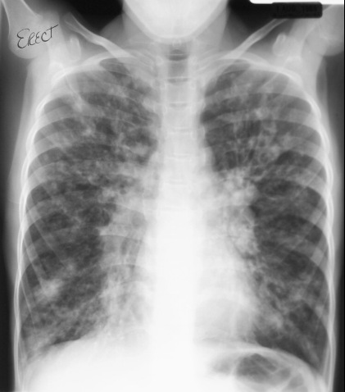
Cystic Fibrosis
Cystic fibrosis (CF): An often fatal disease which affects the respiratory system and produces an abnormally large amount of mucus.
  Mucus is a slimy material that coats epithelial surfaces and is secreted into fluids such as saliva.

Slide 13
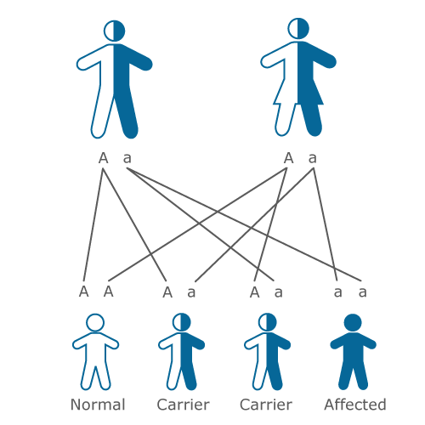
Approximately 1 in 25 Humans Carry a Faulty CF Gene
In the early 1980s biologists hypothesized that CF is caused by mutations in an unidentified gene.
When BOTH parent carry a faulty gene, there is a 25% chance that their child will have cystic fibrosis.

Slide 14
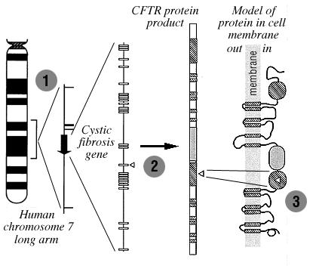
Where Is the Cystic Fibrosis Gene?
In the late 1980s, biologists narrowed the search for the CF gene to a small region on chromosome 7.
One of these genes was similar to ATP binding proteins that act as transport channels responsible for secretion.
Hint: cystic fibrosis involves sweet secretion with abnormally high sodium levels.
Chromosome 7
Adenosine Triphosphate (ATP) transports chemical energy within cells.

Slide 15
Where Is the Cystic Fibrosis Gene?
In the late 1980s, biologists narrowed the search for the CF gene to a small region on chromosome 7.
One of these genes was similar to ATP binding proteins that act as transport channels responsible for secretion.
Hint: cystic fibrosis involves sweet secretion with abnormally high sodium levels.
Adenosine Triphosphate (ATP) transports chemical energy within cells.

Slide 16
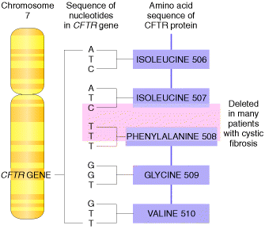
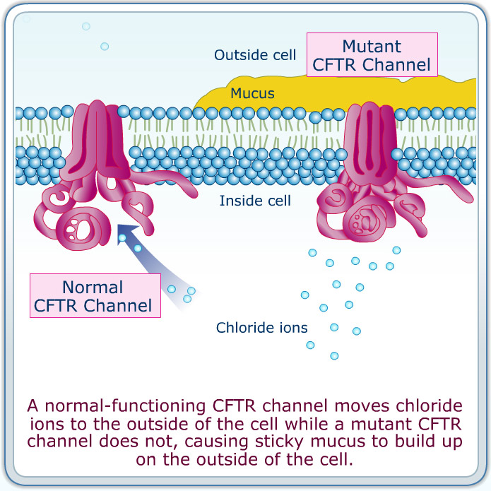
CFTR: Cystic Fibrosis Transmembrane Conductance Regulator
The CFTR protein controls the flow of ions in and out of cells inside the lungs.

Slide 17
How Do We Compare Biological Sequences
From Sequence Comparison to Biological Insights
The Alignment Game and the Longest Common Subsequence
The Manhattan Tourist Problem
The Change Problem
Dynamic Programming and Backtracking Pointers
From Manhattan to the Alignment Graph
From Global to Local Alignment
Penalizing Insertions and Deletions in Sequence Alignment
Space-Efficient Sequence Alignment
Multiple Sequence Alignment

Slide 18
The Alignment Game
A T G T T A T A
A T C G T C C
Alignment Game (maximizing the number of points):
Remove the 1st symbol from each sequence
  1 point if the symbols match, 0 points if they don’t match
Remove the 1st symbol from one of the sequences
  0 points

Slide 19
The Alignment Game
A T G T T A T A
A T C G T C C
+1

Slide 20
The Alignment Game
A T G T T A T A
A T C G T C C
+1+1

Slide 21
The Alignment Game
A T - G T T A T A
A T C G T C C
+1+1

Slide 22
The Alignment Game
A T - G T T A T A
A T C G T C C
+1+1 +1

Slide 23
The Alignment Game
A T - G T T A T A
A T C G T C C
+1+1 +1+1

Slide 24
The Alignment Game
A T - G T T A T A
A T C G T - C C
+1+1 +1+1

Slide 25
The Alignment Game
A T - G T T A T A
A T C G T - C C
+1+1 +1+1

Slide 26
The Alignment Game
A T - G T T A T A
A T C G T - C - C
+1+1 +1+1

Slide 27
The Alignment Game
A T - G T T A T A
A T C G T - C - C
+1+1 +1+1 =4

Slide 28
What Is the Sequence Alignment?
matches insertions deletions mismatches
A T - G T T A T A
A T C G T - C - C
+1+1 +1+1 =4
Alignment of two sequences is a two-row matrix:
1st row: symbols of the 1st sequence (in order) interspersed by “-”
2nd row: symbols of the 2nd sequence (in order) interspersed by “-”

Slide 29
Longest Common Subsequence
A T - G T T A T A
A T C G T - C - C
Matches in alignment of two sequences (ATGT) form their
Common Subsequence
Longest Common Subsequence Problem: Find a longest common subsequence of two strings.
  Input: Two strings.
  Output: A longest common subsequence of these strings.

Slide 30
How Do We Compare Biological Sequences
From Sequence Comparison to Biological Insights
The Alignment Game and the Longest Common Subsequence
The Manhattan Tourist Problem
The Change Problem
Dynamic Programming and Backtracking Pointers
From Manhattan to the Alignment Graph
From Global to Local Alignment
Penalizing Insertions and Deletions in Sequence Alignment
Space-Efficient Sequence Alignment
Multiple Sequence Alignment

Slide 31

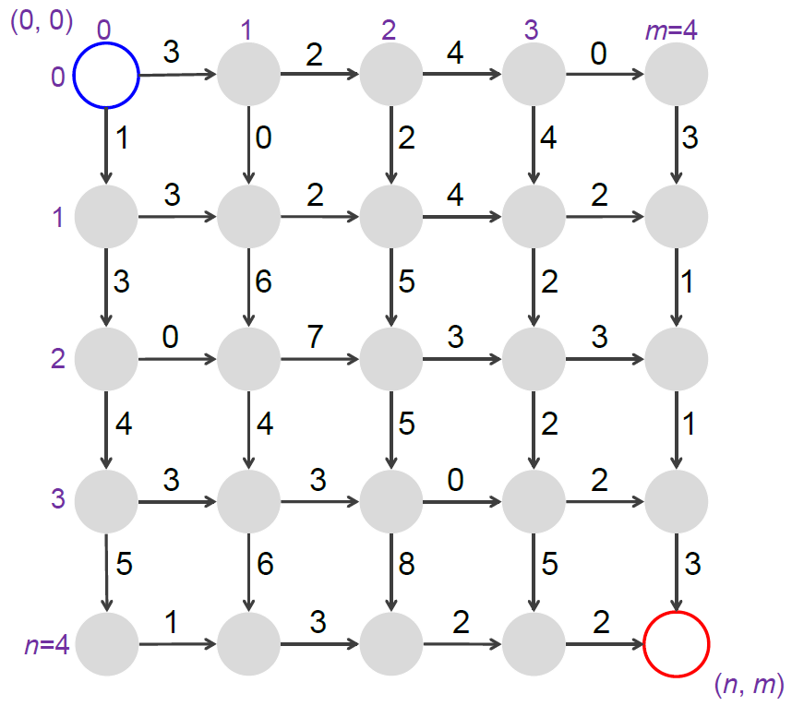
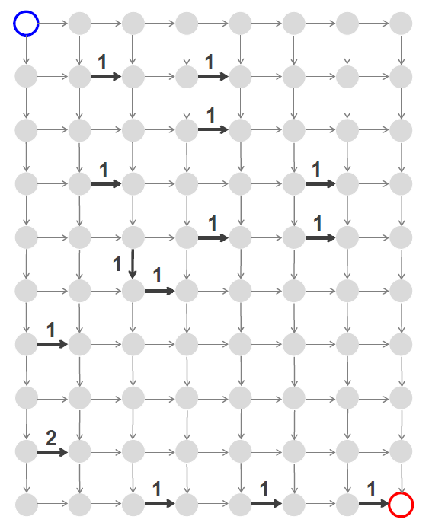
From Manhattan to a Grid Graph
Walk from the source to the sink (only in the South ↓ and East → directions) and visit the maximum number of attractions

Slide 32
Manhattan Tourist Problem
Manhattan Tourist Problem: Find a longest path in a rectangular city grid.
  Input: A weighted rectangular grid.
  Output: A longest path from the source to the sink in the grid.

Slide 33
3
2
4
0
0
3
1
0
2
4
3
3
2
4
2
3
6
5
2
1
Greedy algorithm?
0
7
3
3
4
4
5
2
1
3
3
0
2
5
6
8
5
3
1
3
2
2

Slide 34
3
2
4
0
0
3
5
9
1
0
2
4
3
3
2
4
2
13
3
6
5
2
1
Greedy algorithm?
0
7
3
3
15
19
4
4
5
2
1
3
3
0
2
20
5
6
8
5
3
1
3
2
2
23

Slide 35
3
2
4
0
5
1
4
2
3
From a regular to an irregular grid
4
3
2
4
2
3
6
5
1
0
7
2
3
4
4
4
4
6
2
1
3
3
0
2
5
6
8
5
3
1
3
2
2

Slide 36
Search for Longest Paths in a Directed Graph
Longest Path in a Directed Graph Problem: Find a longest path between two nodes in an edge-weighted directed graph.
  Input: An edge-weighted directed graph with source and sink nodes.
  Output: A longest path from source to sink in the directed graph.

Slide 37
Do You See a Connection between the Manhattan Tourist and the Alignment Game?
A T - G T T A T A
A T C G T - C - C
↘ ↘ → ↘ ↘ ↓ ↘ ↓ ↘

Slide 38
A
T
C
G
T
C
C
A
?
alignment → path
T
A T - G T T A T A
A T C G T - C - C
↘ ↘ → ↘ ↘ ↓ ↘ ↓ ↘
G
T
T
A
T
A

Slide 39
A
T
C
G
T
C
C
A
?
alignment → path
T
A T - G T T A T A
A T C G T - C - C
↘ ↘ → ↘ ↘ ↓ ↘ ↓ ↘
G
T
T
A
T
A

Slide 40
A
T
C
G
T
C
C
A
?
path → alignment
T
A T G T T - A T A
- - A T C G T C C
↓ ↓ ↘ ↘ ↘ → ↘ ↘ ↘
G
T
highest-scoring alignment
=
longest path in a
properly built Manhattan
T
A
T
A

Slide 41
A
T
C
G
T
C
C
How to built a Manhattan for the Alignment Game and the
Longest Common Subsequence Problem?
A
T
G
T
T
Diagonal red edges correspond to matching symbols and have scores 1
A
T
A

Slide 42
How Do We Compare Biological Sequences
From Sequence Comparison to Biological Insights
The Alignment Game and the Longest Common Subsequence
The Manhattan Tourist Problem
The Change Problem
Dynamic Programming and Backtracking Pointers
From Manhattan to the Alignment Graph
From Global to Local Alignment
Penalizing Insertions and Deletions in Sequence Alignment
Space-Efficient Sequence Alignment
Multiple Sequence Alignment

Slide 43
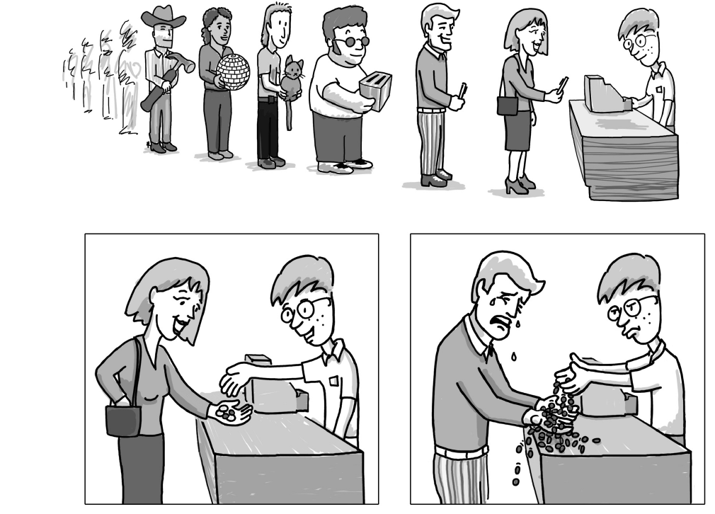
The Change Problem
Change Problem: Find the minimum number of coins needed to make change.
  Input: An integer money and an array of positive integers (coin₁, . . . , coin_{d}).
  Output: The minimum number of coins with denominations (coin₁, . . . , coin_{d}) that changes money.

Slide 44
Changing Money in a Greedy Way
GreedyChange(money)
change ← empty collection of coins
while money > 0
coin ← largest denomination that does not exceed money
add coin to change
money ← money – coin
return change

Slide 45
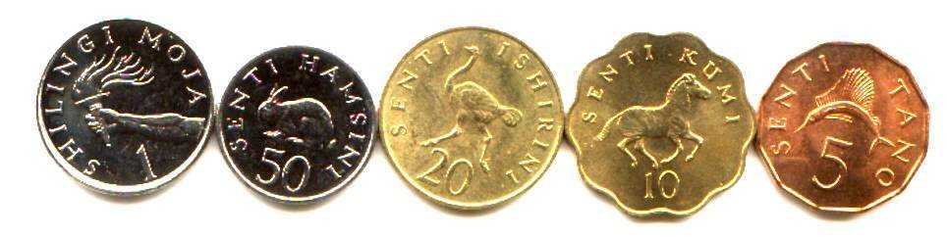

Changing Money in Tanzania
40 cents = 25+10+5
Greedy

Slide 46
Changing Money in Tanzania: GreedyChange Fails
40 cents = 25+10+5 = 20+20
Greedy is not Optimal

Slide 47
Recursive Change
Given the denominations 6, 5, and 1, what is the minimum number of coins needed to change 9 cents?
money
1
2
3
4
5
6
7
8
9
10
11
12
MinNumCoins
?
MinNumCoins(9)=
?

Slide 48
Recursive Change
Given the denominations 6, 5, and 1, what is the minimum number of coins needed to change 9 cents?
money
1
2
3
4
5
6
7
8
9
10
11
12
MinNumCoins
?
?
?
?
MinNumCoins(9)=
?

Slide 49
Recursive Change
Given the denominations 6, 5, and 1, what is the minimum number of coins needed to change 9 cents?
money
1
2
3
4
5
6
7
8
9
10
11
12
MinNumCoins
?
?
?
?
MinNumCoins(9-6)+1 = MinNumCoins(3)+1
MinNumCoins(9)= MinNumCoins(9-5)+1 = MinNumCoins(4)+1
MinNumCoins(9-1)+1 = MinNumCoins(8)+1
min{

Slide 50
Recursive Change
Given the denominations 6, 5, and 1, what is the minimum number of coins needed to change 9 cents?
money
1
2
3
4
5
6
7
8
9
10
11
12
MinNumCoins
?
?
?
?
MinNumCoins(3)=
MinNumCoins(4)=
MinNumCoins(8)=
?

Slide 51
Recursive Change
Given the denominations 6, 5, and 1, what is the minimum number of coins needed to change 9 cents?
money
1
2
3
4
5
6
7
8
9
10
11
12
MinNumCoins
?
?
?
?
?
?
MinNumCoins(3)=
MinNumCoins(4)=
MinNumCoins(8)=
?

Slide 52
Recursive Change
Given the denominations 6, 5, and 1, what is the minimum number of coins needed to change 9 cents?
money
1
2
3
4
5
6
7
8
9
10
11
12
MinNumCoins
?
?
?
?
?
?
MinNumCoins(money-6) + 1
MinNumCoins(money)= MinNumCoins(money-5) + 1
MinNumCoins(money-1) + 1
min{

Slide 53
Recursive Change
Given the denominations 6, 5, and 1, what is the minimum number of coins needed to change 9 cents?
money
1
2
3
4
5
6
7
8
9
10
11
12
MinNumCoins
?
?
?
?
?
?
MinNumCoins(money-coin₁) + 1
. ........................... MinNumCoins(money-coin_{d}) + 1
min{
MinNumCoins(money)=

Slide 54
RecursiveChange
RecursiveChange(money, coins)
if money = 0
return 0
MinNumCoins ← infinity
for i ← 1 to |coins|
if money ≥ coin_{i}
NumCoins ← RecursiveChange(money-coin_{i}, coins)
if numCoins + 1 < MinNumCoins
MinNumCoins ← numCoins + 1
return MinNumCoins

Slide 55
How Fast is the RecursiveChange?
76

Slide 56
The Recursive Tree
76
70
71
75

Slide 57
The Recursive Tree
76
70
71
75
64
65
69
65
66
70
69
70
74

Slide 58
The Recursive Tree
76
70
71
75
64
65
69
65
66
70
69
70
74
58
59
63
63
64
68
60
61
65
63
64
68
68
69
73
59
60
64
59
60
64
64
65
69
64
65
69
the optimal coin combination for 69 cents is computed 6 times!
the optimal coin combination for 30 cents is computed trillions of times!

Slide 59
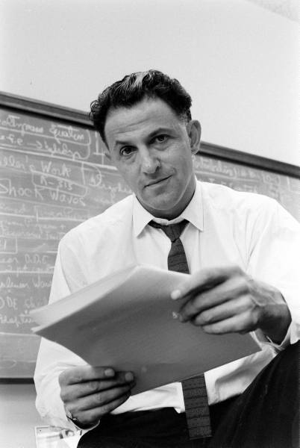
Changing Money by Dynamic Programming
Hint. Wouldn’t it be nice to know all the values of
MinNumCoins(money – coin_{i})
by the time we need to compute
MinNumCoins(money)?
Richard
Bellman
Instead of the time-consuming calls:
RecursiveChange(money-coin_{i}, Coins, d)
we would simply look up the values of
MinNumCoins(money - coin_{i})

Slide 60
Changing Money by Dynamic Programming
Given the denominations 6, 5, and 1, what is the minimum number of coins needed to change 9 cents?
money
0
1
2
3
4
5
6
7
8
9
10
11
12
MinNumCoins
0
1
2
3
4
1
1
2
3
?

Slide 61
DPChange
DPChange(money, coins)
MinNumCoins(0) ← 0
for m ← 1 to money
MinNumCoins(m) ← infinity
for i ← 1 to |coins|
if m ≥ coin_{i}
if MinNumCoins(m – coin_{i}) + 1 < MinNumCoins(m)
MinNumCoins(m) ← MinNumCoins(m – coin_{i})+ 1
return MinNumCoins(money)

Slide 62
Two key features
Two key features of an optimization problem to be suitable for a dynamic programming solution:
1. optimal substructures
2. overlapping subinstances
Subinstances are dependent.
(otherwise a divide-and-conquer approach would be the choice)
Each substructure is optimal.
(principle of optimality)

Slide 63
“Programming” in “Dynamic Programming”
Has Nothing to Do with Programming!
Richard Bellman developed this idea in 1950s working on an Air Force project.
At that time, his approach seemed completely impractical.
He wanted to hide that he is really doing math from the Secretary of Defense.
Richard
Bellman
“…What name could I choose? I was interested in planning but planning, is not a good word for various reasons. I decided therefore to use the word, “programming” and I wanted to get across the idea that this was dynamic. It was something not even a Congressman could object to. So I used it as an umbrella for my activities.”

Slide 64
How Do We Compare Biological Sequences
From Sequence Comparison to Biological Insights
The Alignment Game and the Longest Common Subsequence
The Manhattan Tourist Problem
The Change Problem
Dynamic Programming and Backtracking Pointers
From Manhattan to the Alignment Graph
From Global to Local Alignment
Penalizing Insertions and Deletions in Sequence Alignment
Space-Efficient Sequence Alignment
Multiple Sequence Alignment

Slide 65
3
2
4
0
There are only 2 ways to arrive to the sink:
by moving South ↓
or by moving East →
1
0
2
4
3
3
2
4
2
3
6
5
2
1
0
7
3
3
4
4
5
2
1
3
3
0
2
5
6
8
5
3
South or East?
1
3
2
2
Notes:
scratch

Slide 66
South or East?
SouthOrEast(n,m)
if n=0 and m=0
return 0
if n>0 and m>0
x ← SouthOrEast(n-1,m)+weight of edge “↓”into (n,m)
y ← SouthOrEast(n,m-1)+ weight of edge “→”into (n,m)
return max{x,y}
return -infinity

Slide 67
3
2
4
0
0
1
0
2
4
3
3
2
4
2
1
4
6
5
2
1
0
7
3
3
5
4
4
5
2
1
3
3
0
2
5
6
8
5
3
1
3
2
2
Notes:
Figure 5

Slide 68
3
2
4
0
0
3
5
9
9
1
0
2
4
3
3
2
4
2
1
4
6
5
2
1
0
7
3
3
5
4
4
5
2
1
3
3
0
2
9
5
6
8
5
3
1
3
2
2
14
Notes:
Figure 5

Slide 69
3
2
4
0
0
3
5
9
9
South or East?
1
0
2
4
3
3
2
4
2
1
4
1+3 > 3+0
4
6
5
2
1
0
7
3
3
5
4
4
5
2
1
3
3
0
2
9
5
6
8
5
3
1
3
2
2
14
Notes:
Figure 5

Slide 70
3
2
4
0
0
3
5
9
9
We arrived to (1,1)
by the bold edge:
1
0
2
4
3
3
2
4
2
1
4
3
4
6
5
2
1
4
0
7
3
3
5
4
4
5
2
1
3
3
0
2
9
5
6
8
5
3
1
3
2
2
14
Notes:
Figure 6

Slide 71
3
2
4
0
0
3
5
9
9
South or East?
1
0
2
4
3
3
2
4
2
1
4
5+0 < 4+6
4
6
5
2
1
0
7
3
3
5
10
4
4
5
2
1
3
3
0
2
9
5
6
8
5
3
1
3
2
2
14
Notes:
Figure 6

Slide 72
3
2
4
0
0
3
5
9
9
We arrived to (2,1)
by the bold edge:
1
0
2
4
3
3
2
4
2
1
4
4
6
5
2
1
6
0
7
3
3
5
10
10
4
4
5
2
1
3
3
0
2
9
5
6
8
5
3
1
3
2
2
14
Notes:
Figure 6

Slide 73
3
2
4
0
0
3
5
9
9
1
0
2
4
3
3
2
4
2
1
4
4
6
5
2
1
0
7
3
3
5
10
4
4
5
2
1
3
3
0
2
9
14
5
6
8
5
3
1
3
2
2
14
20
Notes:
Figure 7

Slide 74
3
2
4
0
0
3
5
9
9
South or East?
1
0
2
4
3
3
2
4
2
1
4
7
5+2 > 4+2
4
6
5
2
1
0
7
3
3
5
10
4
4
5
2
1
3
3
0
2
9
14
5
6
8
5
3
1
3
2
2
14
20
Notes:
Figure 7

Slide 75
3
2
4
0
0
3
5
9
9
South or East?
1
0
2
4
3
3
2
4
2
1
4
7
5+2 > 4+2
4
6
5
2
1
0
7
3
3
5
10
4
4
5
2
1
3
3
0
2
9
14
5
6
8
5
3
1
3
2
2
14
20
Notes:
Figure 7

Slide 76
3
2
4
0
0
3
5
9
9
1
0
2
4
3
3
2
4
2
1
4
7
13
15
4
6
5
2
1
0
7
3
3
5
10
17
20
24
4
4
5
2
1
3
3
0
2
9
14
22
22
25
5
6
8
5
3
1
3
2
2
14
20
30
32
34
Notes:
Figure 8a

Slide 77
3
2
4
0
0
3
5
9
9
1
2
4
Backtracking pointers:
the best way to get to each node
3
2
1
4
7
13
15
4
6
7
3
3
5
10
17
20
24
4
4
5
2
1
9
14
22
22
25
5
6
8
2
2
14
20
30
32
34
Notes:
Figure 8a

Slide 78
Dynamic Programming Recurrence
s_{i, j}: the length of a longest path from (0,0) to (i,j)
s_{i-1, j} + weight of edge “↓”into (i,j)
s_{i, j-1} + weight of edge “→”into (i,j)
s_{i, j} = max {

Slide 79
How Do We Compare Biological Sequences
From Sequence Comparison to Biological Insights
The Alignment Game and the Longest Common Subsequence
The Manhattan Tourist Problem
The Change Problem
Dynamic Programming and Backtracking Pointers
From Manhattan to the Alignment Graph
From Global to Local Alignment
Penalizing Insertions and Deletions in Sequence Alignment
Space-Efficient Sequence Alignment
Multiple Sequence Alignment

Slide 80
3
2
4
0
0
3
5
How does the recurrence change for this graph?
5
1
5
4
7
2
3
3
4
3
2
4
1
4
2
3
6
5
1
4
0
7
2
3
4
4
4
4
6
2
1
3
3
0
2
5
6
8
5
3
1
3
2
2

Slide 81
s_{a} = max_{all predecessors b of node a}{s_{b}+ weight of edge from b to a}
3
2
4
0
0
3
5
4 choices:
5 + 2
3 + 7
5 + 4
4 + 2
5
1
5
4
7
2
3
3
4
3
2
4
1
4
10
?
2
3
6
5
1
4
0
7
2
3
4
4
4
4
6
2
1
3
3
0
2
5
6
8
5
3
1
3
2
2

Slide 82
s_{a} = max_{all predecessors b of node a}{s_{b}+ weight of edge from b to a}
3
2
4
0
0
3
5
9
9
4 choices:
5 + 2
3 + 7
5 + 4
4 + 2
5
1
5
4
7
2
3
3
4
3
2
4
1
4
10
14
18
?
2
3
6
5
1
4
12
0
7
2
3
4
10
17
14
19
4
4
4
4
6
2
1
3
3
0
2
8
14
17
17
20
5
6
8
5
3
1
3
2
2
13
20
25
27
29

Slide 83
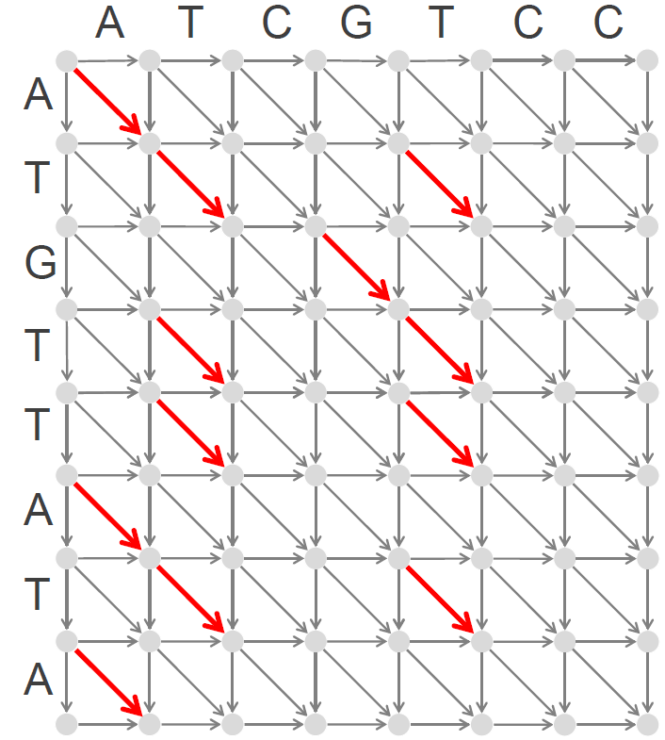
Dynamic Programming Recurrence for the Alignment Graph
s_{i, j}: the length of a longest path from (0,0) to (i,j)
s_{i-1, j} + weight of edge “↓” into (i,j)
s_{i, j-1} + weight of edge “→” into (i,j)
s_{i-1, j-1}+ weight of edge “↘” into (i,j)
{
s_{i, j}= max
red edges ↘ – weight 1
other edges – weight 0

Slide 84
Dynamic Programming Recurrence for the Longest Common Subsequence Problem
s_{i, j}: the length of a longest path from (0,0) to (i,j)
s_{i-1, j} + 0
s_{i, j-1} + 0
s_{i-1, j-1}+ 1, if v_{i}=w_{j}
{
s_{i, j}= max
red edges ↘ – weight 1
other edges – weight 0

Slide 85
A
T
C
G
T
C
C
A
backtracking pointers for the Longest Common Subsequence
red edges ↘ – weight 1
other edges – weight 0
T
G
T
T
A
T
A

Slide 86
A
T
C
G
T
C
C
A
backtracking pointers for the Longest Common Subsequence
T
G
T
T
A
T
A

Slide 87
Computing Backtracking Pointers
s_{i,j-1}+0
s_{i,j} ← max{ s_{i-1,j}+0
s_{i-1,j-1}+1, if v_{i}=w_{j}
“→”, if s_{i,j}=s_{i,j-1}
backtrack_{i,j} ← {“↓", if s_{i,j}=s_{i-1,j}
“↘”, if s_{i,j}=s_{i-1,j-1}+1

Slide 88
3
2
4
0
0
3
5
9
9
Why did we store the backtracking pointers?
1
2
4
3
2
1
4
7
13
15
4
6
7
3
3
5
10
17
20
24
4
4
5
2
1
9
14
22
22
25
5
6
8
2
2
14
20
30
32
34
Notes:
Figure 8a

Slide 89
3
2
4
0
0
3
5
9
9
What is the optimal alignment path?
1
2
4
3
2
1
4
7
13
15
4
6
7
3
3
5
10
17
20
24
4
4
5
2
1
9
14
22
22
25
5
6
8
2
2
14
20
30
32
34
Notes:
Figure 8a

Slide 90
A
T
C
G
T
C
C
A
backtracking pointers for the Longest Common Subsequence
T
G
T
T
A
T
A

Slide 91
Using Backtracking Pointers to Compute LCS
OutputLCS (backtrack, v, i, j)
if i = 0 or j = 0
return
if backtrack_{i,j} = “→”
OutputLCS (backtrack, v, i, j-1)
else if backtrack_{i,j} = “↓”
OutputLCS (backtrack, v, i-1, j)
else
OutputLCS (backtrack, v, i-1, j-1)
output v_{i}

Slide 92
Computing Scores of ALL Predecessors
4
0
4
4
?
1
6
1
1
2
1
2
6
2
s_{a} = max_{ALL predecessors b of node a}{s_{b}+ weight of edge from b to a}

Slide 93
4
0
4
4
?
1
6
1
1
2
1
?
2
6
2

Slide 94
4
0
4
4
?
1
6
1
1
2
1
?
?
2
6
2

Slide 95
4
0
4
4
?
?
1
6
1
1
2
1
?
?
2
6
2

Slide 96
A Vicious Cycle
4
0
4
4
?
?
1
6
1
1
2
1
?
?
2
6
2

Slide 97
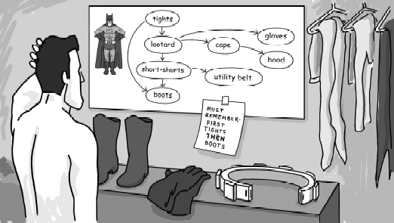
In What Order Should We Explore Nodes of the Graph?
s_{a} = max_{ALL predecessors b of node a}{s_{b}+ weight of edge from b to a}
By the time a node is analyzed, the scores of all its predecessors should already be computed.
If the graph has a directed cycle, this condition is impossible to satisfy.
Directed Acyclic Graph (DAG): a graph without directed cycles.

Slide 98
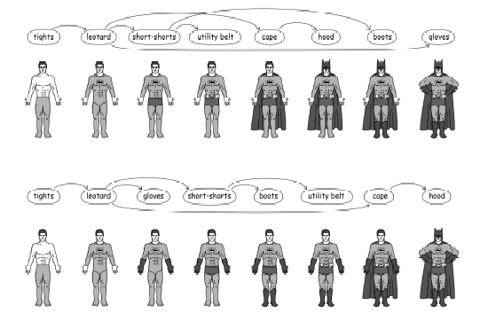
Topological Ordering
Topological Ordering: Ordering of nodes of a DAG on a line such that all edges go from left to right.
Theorem: Every DAG has a topological ordering.

Slide 99
LongestPath
LongestPath(Graph, source, sink)
for each node a in Graph
s_{a} ← -infinity
s_{source} ← 0
topologically order Graph
for each node a (from source to sink in topological order)
s_{a} ← max_{all predecessors b of node a}{s_{b}+ weight of edge from b to a}
return s_{sink}

Slide 100
How Do We Compare Biological Sequences
From Sequence Comparison to Biological Insights
The Alignment Game and the Longest Common Subsequence
The Manhattan Tourist Problem
The Change Problem
Dynamic Programming and Backtracking Pointers
From Manhattan to the Alignment Graph
From Global to Local Alignment
Penalizing Insertions and Deletions in Sequence Alignment
Space-Efficient Sequence Alignment
Multiple Sequence Alignment

Slide 101
Current (Primitive) Scoring
#matches

Slide 102
Mismatches and Indel Penalties
#matches − μ · #mismatches − σ · #indels
A T - G T T A T A
A T C G T - C – C
+1+1-2+1+1-2-3-2-3=-7
A C G T −
A +1 −μ −μ −μ -σ
C −μ +1 −μ −μ -σ
G −μ −μ +1 −μ -σ
T −μ −μ –μ +1 -σ
− -σ -σ -σ -σ
A C G T −
A +1 −3 −5 −1 -3
C −4 +1 −3 −2 -3
G −9 −7 +1 −1 -3
T −3 −5 –8 +1 -4
− -4 -2 -2 -1
Scoring matrix
Even more general scoring matrix

Slide 103
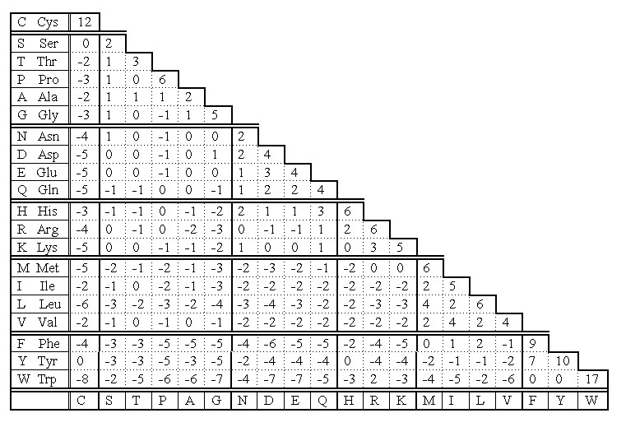
Scoring Matrices for Amino Acid Sequences
Y (Tyr) often mutates into F (score +7)
but rarely mutates into P (score -5)
-5
7

Slide 104
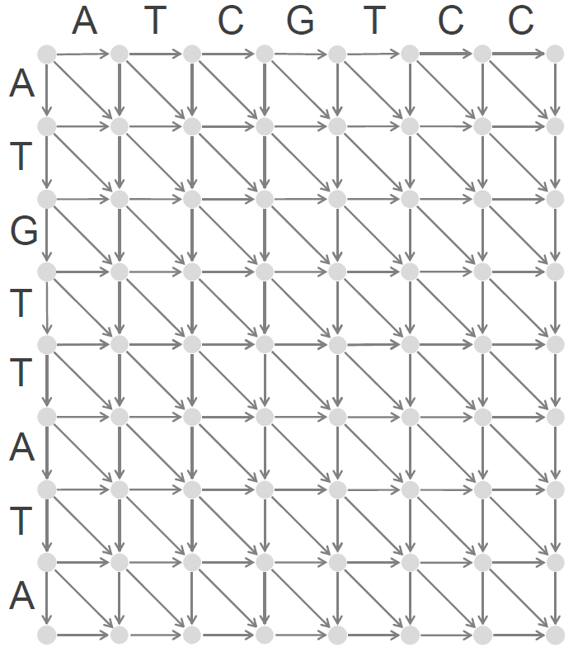
Dynamic Programming Recurrence for the Alignment Graph
s_{i-1, j} + weight of edge “↓” into (i,j)
s_{i, j-1} + weight of edge “→” into (i,j)
s_{i-1, j-1}+ weight of edge “↘” into (i,j)
{
s_{i, j}= max

Slide 105
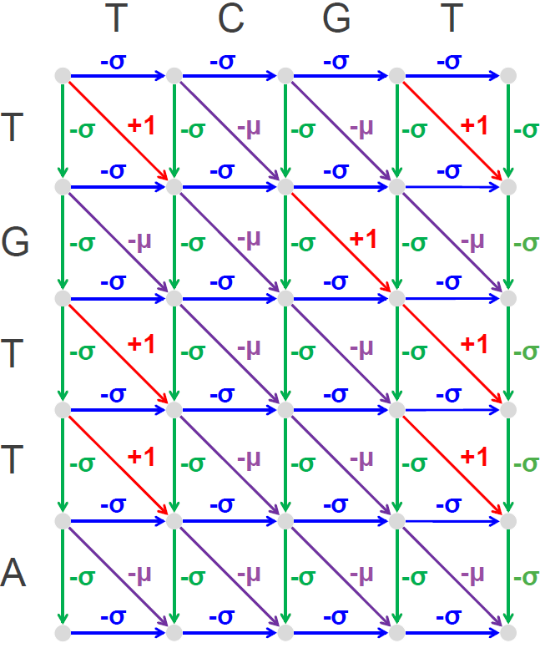
Dynamic Programming Recurrence for the Alignment Graph
s_{i-1, j} - σ
s_{i, j-1} - σ
s_{i-1, j-1} + 1, if v_{i}=w_{j}
s_{i-1, j-1} - μ, if v_{i}≠w_{j}
{
s_{i, j}= max

Slide 106
Dynamic Programming Recurrence for the Alignment Graph
s_{i-1, j} + score(v_{i},-)
s_{i, j-1} + score(-,w_{j})
s_{i-1, j-1}+ score(v_{i},w_{j})
{
s_{i, j}= max

Slide 107
Global Alignment
Global Alignment Problem: Find the highest-scoring alignment between two strings by using a scoring matrix.
  Input: Strings v and w as well as a matrix score.
  Output: An alignment of v and w whose alignment score (as defined by the scoring matrix score) is maximal among all possible alignments of v and w.

Slide 108
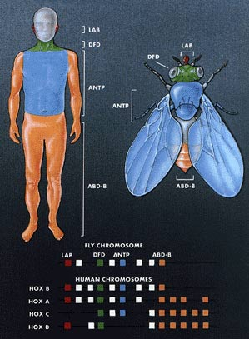
Homeobox Genes
Two genes in different species may be similar over short conserved regions and dissimilar over remaining regions.
Homeobox genes have a short region called the homeodomain that is highly conserved among species.
    A global alignment may not find the homeodomain because it would try to align the entire sequence.

Slide 109
Which Alignment is Better?
Alignment 1: score = 22 (matches) - 20 (indels)=2.
Alignment 2: score = 17 (matches) - 30 (indels)=-13.
GCC-C-AGT--TATGT-CAGGGGGCACG--A-GCATGCAGA-
GCCGCC-GTCGT-T-TTCAG----CA-GTTATG--T-CAGAT
---G----C-----C--CAGTTATGTCAGGGGGCACGAGCATGCAGA
GCCGCCGTCGTTTTCAGCAGTTATGTCAG-----A------T-----

Slide 110
Which Alignment is Better?
Alignment 1: score = 22 (matches) - 20 (indels)=2.
Alignment 2: score = 17 (matches) - 30 (indels)=-13.
GCC-C-AGT--TATGT-CAGGGGGCACG--A-GCATGCAGA-
GCCGCC-GTCGT-T-TTCAG----CA-GTTATG--T-CAGAT
---G----C-----C--CAGTTATGTCAGGGGGCACGAGCATGCAGA
GCCGCCGTCGTTTTCAGCAGTTATGTCAG-----A------T-----
local alignment

Slide 111
G C C G C C G T C G T T T T C A G C A G T T A T G T C A G A T
G
C
C
C
A
G
T
T
A
T
G
T
C
A
G
G
G
G
G
C
A
C
G
A
G
C
A
T
G
C
A
C
A
−−−G−−−−C−−−−−C−−CAGTTATGTCAGGGGGCACGAGCATGCAGA
GCCGCCGTCGTTTTCAGCAGTTATGTCAG−−−−−A−−−−−−T −−−−
Local alignment
GCC−C−AGT−TATGT-CAGGGGGCACG−−A−GCATGCAGA-
GCCGCC−GTCGT-T-TTCAG----CA−GTTATG−T−CAGAT
Global alignment
Notes:
--T--CC-C-AGT—-TATGT-CAGGGGGCACG—-A-GCATGCACA-GAC
AATTGCCGCC-GTCGT-T-TTCAG----CA-GTTATG—-T-CAGAT--C

Slide 112
G C C G C C G T C G T T T T C A G C A G T T A T G T C A G A T
G
C
C
C
A
G
T
T
A
T
G
T
C
A
G
G
G
G
G
C
A
C
G
A
G
C
A
T
G
C
A
C
A
Notes:
--T--CC-C-AGT—-TATGT-CAGGGGGCACG—-A-GCATGCACA-GAC
AATTGCCGCC-GTCGT-T-TTCAG----CA-GTTATG—-T-CAGAT--C

Slide 113
Local Alignment
Global alignment

Slide 114
Local Alignment= Global Alignment in a Subrectangle
Compute a Global Alignment within each rectangle to get a Local Alignment
Global alignment

Slide 115
Local Alignment Problem
Local Alignment Problem: Find the highest-scoring local alignment between two strings.
Input: Strings v and w as well as a matrix score.
Output: Substrings of v and w whose global alignment (as defined by the matrix score), is maximal among all global alignments of all substrings of v and w.

Slide 116

Free Taxi Rides!
G C C G C C G T C G T T T T C A G C A G T T A T G T C A G A T
G
C
C
C
A
G
T
T
A
T
G
T
C
A
G
G
G
G
G
C
A
C
G
A
G
C
A
T
G
C
A
C
A
GCC−C−AGT−TATGT-CAGGGGGCACG−−A−GCATGCACA-
GCCGCC−GTCGT-T-TTCAG----CA−GTTATG−T−CAGAT
Global alignment
−−−G−−−−C−−−−−C−−CAGTTATGTCAGGGGGCACGAGCATGCACA
GCCGCCGTCGTTTTCAGCAGTTATGTCAG−−−−−A−−−−−−T −−−−
Local alignment
Notes:
--T--CC-C-AGT—-TATGT-CAGGGGGCACG—-A-GCATGCACA-GAC
AATTGCCGCC-GTCGT-T-TTCAG----CA-GTTATG—-T-CAGAT--C

Slide 117
What Do Free Taxi Rides Mean in the Terms of the Alignment Graph?
Notes:
scratch

Slide 118
Building Manhattan for the Local Alignment Problem
How many edges have we added?
Notes:
scratch

Slide 119
Dynamic Programming for the Local Alignment
weight of edge from (0,0) to (i,j)
s_{i-1, j} + weight of edge “↓” into (i,j)
s_{i, j-1} + weight of edge “→” into (i,j)
s_{i-1, j-1}+ weight of edge “↘” into (i,j)
{
s_{i, j}= max

Slide 120
Dynamic Programming for the Local Alignment
0
s_{i-1, j} + weight of edge “↓” into (i,j)
s_{i, j-1} + weight of edge “→” into (i,j)
s_{i-1, j-1}+ weight of edge “↘” into (i,j)
{
s_{i, j}= max

Slide 121
How Do We Compare Biological Sequences
From Sequence Comparison to Biological Insights
The Alignment Game and the Longest Common Subsequence
The Manhattan Tourist Problem
The Change Problem
Dynamic Programming and Backtracking Pointers
From Manhattan to the Alignment Graph
From Global to Local Alignment
Penalizing Insertions and Deletions in Sequence Alignment
Space-Efficient Sequence Alignment
Multiple Sequence Alignment

Slide 122
Scoring Gaps
We previously assigned a fixed penalty σ to each indel.
However, this fixed penalty may be too severe for a series of 100 consecutive indels.
A series of k indels often represents a single evolutionary event (gap) rather than k events:
two gaps
(lower score)
GATCCAG GATCCAG
GA-C-AG GA--CAG
a single gap
(higher score)

Slide 123
More Adequate Gap Penalties
Affine gap penalty for a gap of length k: σ+ε∙(k-1)
  σ - the gap opening penalty
  ε - the gap extension penalty
  σ > ε, since starting a gap should be penalized more than extending it.

Slide 124
Modelling Affine Gap Penalties by Long Edges

Slide 125
Building Manhattan with Affine Gap Penalties
σ+ε∙2
σ+ε σ+ε
We have just added O(n³) edges to the graph…
Notes:
scratch

Slide 126
Building Manhattan on 3 levels
upper level
(deletions)
bottom level
(insertions)
middle level
(matches/mismatches)

Slide 127
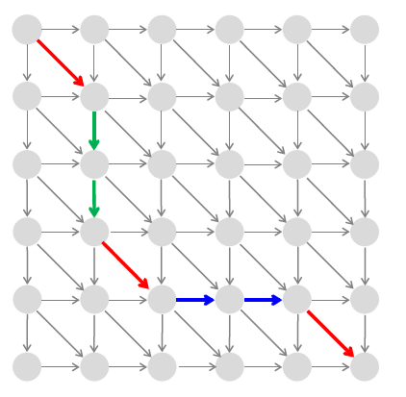
How can we emulate this path in the 3-level Manhattan?
ε
lower_{i-1,j} - ε middle_{i-1,j} - σ
σ
lower_{i,j} = max {
0
σ
upper_{i,j-1} - ε middle_{i,j-1} - σ
upper_{i,j} = max {
0
lower_{i,j} middle_{i-1,j-1} + score(v_{i},w_{j})
upper_{i,j}
ε
middle_{i,j} = max {

Slide 128
How Do We Compare Biological Sequences
From Sequence Comparison to Biological Insights
The Alignment Game and the Longest Common Subsequence
The Manhattan Tourist Problem
The Change Problem
Dynamic Programming and Backtracking Pointers
From Manhattan to an Arbitrary Directed Acyclic Graph
From Global to Local Alignment
Penalizing Insertions and Deletions in Sequence Alignment
Space-Efficient Sequence Alignment
Multiple Sequence Alignment

Slide 129
Middle Column of the Alignment
A C G G A A
A
T
T
C
A
A
middle column
(middle=#columns/2)

Slide 130
Middle Node of the Alignment
A C G G A A
A
T
T
C
A
A
middle node
(a node where an optimal alignment path crosses the middle column)

Slide 131
Divide and Conquer Approach to Sequence Alignment
A C G G A A
AlignmentPath(source, sink)
find MiddleNode
A
T
T
C
A
A

Slide 132
Divide and Conquer Approach to Sequence Alignment
A C G G A A
AlignmentPath(source, sink)
find MiddleNode
AlignmentPath(source, MiddleNode)
A
T
T
C
A
A

Slide 133
Divide and Conquer Approach to Sequence Alignment
A C G G A A
AlignmentPath(source, sink)
find MiddleNode
AlignmentPath(source, MiddleNode)
AlignmentPath(MiddleNode, sink)
A
T
T
C
A
A
The only problem left is how to find this middle node in linear space!

Slide 134
Computing Alignment Score in Linear Space
Finding the longest path in the alignment graph requires storing all backtracking pointers – O(nm) memory.
Finding the length of the longest path in the alignment graph does not require storing any backtracking pointers – O(n) memory.

Slide 135
Recycling the Columns in the Alignment Graph
A C G G A A
0
0
0
0
0
0
0
A
T
T
C
A
A
0
1
1
1
1
1
1
0
1
1
1
1
1
1
0
1
1
1
1
1
1
0
1
2
2
2
2
2
0
1
2
2
2
3
3
0
1
2
2
2
3
4

Slide 136
Can We Find the Middle Node without Constructing the Longest Path?
A C G G A A
A
T
T
C
A
A
4-path that visits the node (4,middle)
In the middle column
i-path – a longest path among paths that visit the i-th node in the middle column

Slide 137
Can We Find The Lengths of All i-paths?
A C G G A A
2
A
T
T
C
A
A
length(i):
length of an i-path:
length(0)=2
length(4)=4
4

Slide 138
Can We Find The Lengths of All i-paths?
A C G G A A
2
A
T
T
C
A
A
3
3
3
4
3
1

Slide 139
Can We Find The Lengths of i-paths?
A C G G A A
2
A
T
T
C
A
A
3
3
3
length(i):
length of an i-path
4
3
1
length(i)=fromSource(i)+toSink(i)

Slide 140
Computing FromSource and toSink
A C G G A A
A C G G A A
0
0
0
0
2
2
1
0
A
T
T
C
A
A
A
T
T
C
A
A
0
1
1
1
2
2
1
0
0
1
1
1
2
2
1
0
0
1
1
1
2
2
1
0
0
1
2
2
2
2
1
0
0
1
2
2
1
1
1
0
0
1
2
2
0
0
0
0
fromSource(i)
toSink(i)

Slide 141
How Much Time Did It Take to Find the Middle Node ?
A C G G A A
A C G G A A
0
0
0
0
2
2
1
0
A
T
T
C
A
A
A
T
T
C
A
A
0
1
1
1
2
2
1
0
0
1
1
1
2
2
1
0
0
area/2
area/2+area/2=area
area/2
1
1
1
2
2
1
0
0
1
2
2
2
2
1
0
0
1
2
2
1
1
1
0
0
1
2
2
0
0
0
0
fromSource(i)
toSink(i)

Slide 142
Laughable Progress: O(nm) Time to Find ONE Node!
G A G C A A T T
A
C
T
T
A
A
T
T
Each subproblem can be conquered in time proportional to its area:
area/4+area/4=
area/2
How much time would it take to conquer 2 subproblems?

Slide 143
Laughable Progress: O(nm+nm/2) Time to Find THREE Nodes!
G A G C A A T T
A
C
T
T
A
A
T
T
Each subproblem can be conquered in time proportional to its area:
area/8+area/8+
area/8+area/8=
area/4
How much time would it take to conquer 4 subproblems?

Slide 144
O(nm+nm/2+nm/4) Time to Find NEARLY ALL Nodes!
G A G C A A T T
A
C
T
T
A
A
T
T
area+
area/2
+area/4
+area/8
+area/16
+….+
<
2∙area
How much time would it take to conquer ALL subproblems?

Slide 145
Total Time: area+area/2+area/4+area/8+area/16+…
3rd pass: 1/4
1st pass: 1 area
4th pass: 1/8
2nd pass: 1/2
1 + ½ + ¼ +... < 2

Slide 146
The Middle Edge
G A G C A A T T
A
C
T
T
A
A
T
T
Middle Edge: an edge in an optimal alignment path starting at the middle node

Slide 147
The Middle Edge Problem
Middle Edge in Linear Space Problem. Find a middle edge in the alignment graph in linear space.
  Input: Two strings and matrix score.
  Output: A middle edge in the alignment graph of these strings (as defined by the matrix score).

Slide 148
G A G C A A T T
A
C
T
T
A
A
T
T

Slide 149
G A G C A A T T
A
C
T
T
A
A
T
T

Slide 150
Recursive LinearSpaceAlignment
LinearSpaceAlignment(top,bottom,left,right)
if left = right
return alignment formed by bottom-top edges “↓”
middle ← ⌊(left+right)/2⌋
midNode ← MiddleNode(top,bottom,left,right)
midEdge ← MiddleEdge(top,bottom,left,right)
LinearSpaceAlignment(top,midNode,left,middle)
output midEdge
if midEdge = “→“ or midEdge = “↘”
middle ← middle+1
if midEdge = “↓“ or midEdge = “↘”
midNode ← midNode+1
LinearSpaceAlignment(midNode,bottom,middle,right)

Slide 151
How Do We Compare Biological Sequences
From Sequence Comparison to Biological Insights
The Alignment Game and the Longest Common Subsequence
The Manhattan Tourist Problem
The Change Problem
Dynamic Programming and Backtracking Pointers
From Manhattan to an Arbitrary Directed Acyclic Graph
From Global to Local Alignment
Penalizing Insertions and Deletions in Sequence Alignment
Space-Efficient Sequence Alignment
Multiple Sequence Alignment

Slide 152
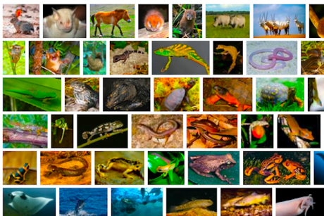


From Pairwise to Multiple Alignment
Up until now we have only tried to align two sequences.
A faint (and statistically insignificant) similarity between two sequences becomes significant if it is present in many other sequences.
Multiple alignments can reveal subtle similarities that pairwise alignments do not reveal.

Slide 153
Alignment of Three A-domains
YAFDLGYTCMFPVLLGGGELHIVQKETYTAPDEIAHYIKEHGITYIKLTPSLFHTIVNTASFAFDANFESLRLIVLGGEKIIPIDVIAFRKMYGHTE-FINHYGPTEATIGA
-AFDVSAGDFARALLTGGQLIVCPNEVKMDPASLYAIIKKYDITIFEATPALVIPLMEYI-YEQKLDISQLQILIVGSDSCSMEDFKTLVSRFGSTIRIVNSYGVTEACIDS
IAFDASSWEIYAPLLNGGTVVCIDYYTTIDIKALEAVFKQHHIRGAMLPPALLKQCLVSA----PTMISSLEILFAAGDRLSSQDAILARRAVGSGV-Y-NAYGPTENTVLS

Slide 154
Alignment of Three A-domains
YAFDLGYTCMFPVLLGGGELHIVQKETYTAPDEIAHYIKEHGITYIKLTPSLFHTIVNTASFAFDANFESLRLIVLGGEKIIPIDVIAFRKMYGHTE-FINHYGPTEATIGA
-AFDVSAGDFARALLTGGQLIVCPNEVKMDPASLYAIIKKYDITIFEATPALVIPLMEYI-YEQKLDISQLQILIVGSDSCSMEDFKTLVSRFGSTIRIVNSYGVTEACIDS
IAFDASSWEIYAPLLNGGTVVCIDYYTTIDIKALEAVFKQHHIRGAMLPPALLKQCLVSA----PTMISSLEILFAAGDRLSSQDAILARRAVGSGV-Y-NAYGPTENTVLS

Slide 155
Alignment of Three A-domains
YAFDLGYTCMFPVLLGGGELHIVQKETYTAPDEIAHYIKEHGITYIKLTPSLFHTIVNTASFAFDANFESLRLIVLGGEKIIPIDVIAFRKMYGHTE-FINHYGPTEATIGA
-AFDVSAGDFARALLTGGQLIVCPNEVKMDPASLYAIIKKYDITIFEATPALVIPLMEYI-YEQKLDISQLQILIVGSDSCSMEDFKTLVSRFGSTIRIVNSYGVTEACIDS
IAFDASSWEIYAPLLNGGTVVCIDYYTTIDIKALEAVFKQHHIRGAMLPPALLKQCLVSA----PTMISSLEILFAAGDRLSSQDAILARRAVGSGV-Y-NAYGPTENTVLS

Slide 156
Generalizing Pairwise to Multiple Alignment
Alignment of 2 sequences is a 2-row matrix.
Alignment of 3 sequences is a 3-row matrix
A T - G C G -
A - C G T - A
A T C A C - A
Our scoring function should score alignments with conserved columns higher.

Slide 157
Alignments = Paths in 3-D
Alignment of ATGC, AATC, and ATGC
 | A | -- | T | G | C
 | A | A | T | -- | C
 | -- | A | T | G | C

Slide 158
Alignments = Paths in 3-D
Alignment of ATGC, AATC, and ATGC
0 | 1 | 1 | 2 | 3 | 4
#symbols up to a given position
 | A | -- | T | G | C
 | A | A | T | -- | C
 | -- | A | T | G | C

Slide 159
Alignments = Paths in 3-D
Alignment of ATGC, AATC, and ATGC
0 | 1 | 1 | 2 | 3 | 4
#symbols up to a given position
 | A | -- | T | G | C
0 | 1 | 2 | 3 | 3 | 4
 | A | A | T | -- | C
 | -- | A | T | G | C

Slide 160
Alignments = Paths in 3-D
Alignment of ATGC, AATC, and ATGC
  (0,0,0)→(1,1,0)→(1,2,1) →(2,3,2) →(3,3,3) →(4,4,4)
0 | 1 | 1 | 2 | 3 | 4
 | A | -- | T | G | C
0 | 1 | 2 | 3 | 3 | 4
 | A | A | T | -- | C
0 | 0 | 1 | 2 | 3 | 4
 | -- | A | T | G | C

Slide 161
2-D Alignment Cell versus 3-D Alignment Cell
(i-1,j-1,k-1)
(i-1,j,k-1)
(i-1,j-1,k)
(i-1,j,k)
2-D
(i,j,k-1)
(i,j-1,k-1)
(i,j-1,k)
(i,j,k)

Slide 162
Multiple Alignment: Dynamic Programming
δ(x, y, z) is an entry in the 3-D scoring matrix.

Slide 163
Multiple Alignment: Running Time
For 3 sequences of length n, the run time is proportional to 7n³
For a k-way alignment, build a k-dimensional Manhattan graph with
  n^{k} nodes
  most nodes have 2^{k} – 1 incoming edges.
  Runtime: O(2^{k}n^{k})

Slide 164
Multiple Alignment Induces Pairwise Alignments
Every multiple alignment induces pairwise alignments:
AC-GCGG-C
AC-GC-GAG
GCCGC-GAG
ACGCGG-C AC-GCGG-C AC-GCGAG
ACGC-GAC GCCGC-GAG GCCGCGAG

Slide 165
Idea: Construct Multiple from Pairwise Alignments
Given a set of arbitrary pairwise alignments, can we construct a multiple alignment that induces them?
AAAATTTT---- ----AAAATTTT TTTTGGGG----
----TTTTGGGG GGGGAAAA---- ----GGGGAAAA

Slide 166
Profile Representation of Multiple Alignment
- A G G C T A T C A C C T G
T A G – C T A C C A - - - G
C A G – C T A C C A - - - G
C A G – C T A T C A C – G G
C A G – C T A T C G C – G G
A 0 1 0 0 0 0 1 0 0 .8 0 0 0 0
C .6 0 0 0 1 0 0 .4 1 0 .6 .2 0 0
G 0 0 1 .2 0 0 0 0 0 .2 0 0 .4 1
T .2 0 0 0 0 1 0 .6 0 0 0 0 .2 0
- .2 0 0 .8 0 0 0 0 0 0 .4 .8 .4 0

Slide 167
Aligning Sequence Against Sequence
In the past we were aligning a sequence against a sequence.
- A G G C T A T C A C C T G
T A G – C T A C C A - - - G
C A G – C T A C C A - - - G
C A G – C T A T C A C – G G
C A G – C T A T C G C – G G
A 0 1 0 0 0 0 1 0 0 .8 0 0 0 0
C .6 0 0 0 1 0 0 .4 1 0 .6 .2 0 0
G 0 0 1 .2 0 0 0 0 0 .2 0 0 .4 1
T .2 0 0 0 0 1 0 .6 0 0 0 0 .2 0
- .2 0 0 .8 0 0 0 0 0 0 .4 .8 .4 0

Slide 168
Aligning Sequence Against Profile
In the past we were aligning a sequence against a sequence.
  Can we align a sequence against a profile?
- A G G C T A T C A C C T G
T A G – C T A C C A - - - G
C A G – C T A C C A - - - G
C A G – C T A T C A C – G G
C A G – C T A T C G C – G G
A 0 1 0 0 0 0 1 0 0 .8 0 0 0 0
C .6 0 0 0 1 0 0 .4 1 0 .6 .2 0 0
G 0 0 1 .2 0 0 0 0 0 .2 0 0 .4 1
T .2 0 0 0 0 1 0 .6 0 0 0 0 .2 0
- .2 0 0 .8 0 0 0 0 0 0 .4 .8 .4 0

Slide 169
Aligning Profile Against Profile
In the past we were aligning a sequence against a sequence.
  Can we align a sequence against a profile?
  Can we align a profile against a profile?
- A G G C T A T C A C C T G
T A G – C T A C C A - - - G
C A G – C T A C C A - - - G
C A G – C T A T C A C – G G
C A G – C T A T C G C – G G
A 0 1 0 0 0 0 1 0 0 .8 0 0 0 0
C .6 0 0 0 1 0 0 .4 1 0 .6 .2 0 0
G 0 0 1 .2 0 0 0 0 0 .2 0 0 .4 1
T .2 0 0 0 0 1 0 .6 0 0 0 0 .2 0
- .2 0 0 .8 0 0 0 0 0 0 .4 .8 .4 0

Slide 170
Multiple Alignment: Greedy Approach
Choose the most similar sequences and combine them into a profile, thereby reducing alignment of k sequences to an alignment of of k – 2 sequences and 1 profile.
Iterate

Slide 171
Greedy Approach: Example
Sequences: GATTCA, GTCTGA, GATATT, GTCAGC.
6 pairwise alignments (premium for match +1, penalties for indels and mismatches -1)
s2 GTCTGA
s4 GTCAGC (score = 2)
s1 GAT-TCA
s2 G-TCTGA (score = 1)
s1 GAT-TCA
s3 GATAT-T (score = 1)
s1 GATTCA--
s4 G—T-CAGC (score = 0)
s2 G-TCTGA
s3 GATAT-T (score = -1)
s3 GAT-ATT
s4 G-TCAGC (score = -1)

Slide 172
Greedy Approach: Example
Since s₂ and s₄ are closest, we consolidate them into a profile:
New set of 3 sequences to align:
s2 GTCTGA
s4 GTCAGC
s_{2,4} = GTCt/aGa/c
s₁ GATTCA
s₃ GATATT
s_{2,4} GTCt/aGa/c

Slide 173
ClustalW
One of the popular multiple alignment tools (cited 75787 times as of 2/4/2024)
‘W’ stands for ‘weighted’ (different parts of the alignment are weighted differently)
Three-step process
  1. Construct pairwise alignments
  2. Build guide tree
  3. Progressive alignment guided by the tree

Slide 174
Step 1: Pairwise Alignment
Align the sequences against each other, giving a similarity matrix
Similarity = exact matches / sequence length (percent identity)
v₁ v₂ v₃ v₄
v₁ -
v₂ .17 -
v₃ .87 .28 -
v₄ .59 .33 .62 -
(.17 means 17 % identical)

Slide 175
Step 2: Guide Tree
Create Guide Tree using the similarity matrix
  ClustalW uses the neighbor-joining method
  Guide tree roughly reflects evolutionary relationship

Slide 176
Step 2: Guide Tree (cont’d)
v₁
v₃
v₄
v₂
v₁ v₂ v₃ v₄
v₁ -
v₂ .17 -
v₃ .87 .28 -
v₄ .59 .33 .62 -
Calculate:
v_{1,3} = alignment (v₁, v₃)
v_{1,3,4} = alignment((v_{1,3}),v₄)
v_{1,2,3,4} = alignment((v_{1,3,4}),v₂)

Slide 177
Step 3: Progressive Alignment
Start by aligning the two sibling sequences
Following the guide tree, align more sequences or previously constructed alignments
Insert gaps as necessary
FOS_RAT PEEMSVTS-LDLTGGLPEATTPESEEAFTLPLLNDPEPK-PSLEPVKNISNMELKAEPFD
FOS_MOUSE PEEMSVAS-LDLTGGLPEASTPESEEAFTLPLLNDPEPK-PSLEPVKSISNVELKAEPFD
FOS_CHICK SEELAAATALDLG----APSPAAAEEAFALPLMTEAPPAVPPKEPSG--SGLELKAEPFD
FOSB_MOUSE PGPGPLAEVRDLPG-----STSAKEDGFGWLLPPPPPPP-----------------LPFQ
FOSB_HUMAN PGPGPLAEVRDLPG-----SAPAKEDGFSWLLPPPPPPP-----------------LPFQ
. . : ** . :.. *:.* * . * **:
Dots and stars show how well-conserved a column is.
Both sequences and regional gaps are weighted. Deeper sequences and gaps in loops are down-weighted and gaps near other gaps are up-weighted.

